Slide 1
An introduction to Raspberry Pi & Python Programming
Mr Martin Thong
Mr Wong Kim Siong
Robotics Connection Pte Ltd
Updated on August 2016

Slide 2
Course objectives:
Be familiar with the Raspberry Pi Hardware
Learn basic python commands
Understand circuit diagrams and assemble them
Use python to control RPi GPIOs
Use RPi to control a robot car, GoPiGo

Slide 3
6-lesson Agenda
Lesson 3
Nested if…else…
Programming buttons as an input to ON/OFF LEDs
Programming buttons to control LED brightness
Lesson 4

Slide 4
Nested if…else…
There are situations that you will need to make decision based on two or more conditions, where outcome of one condition determines the next condition to check. So we use the nested if…else…

Slide 5
Example:
The table below determines whether a person is eligible to play a particular sport based on gender and age.
Gender | Cannot Play | Can Play
Male | Age above 21 | Age 21 & below
Female | Age above 18 | Age 18 & below

Slide 6
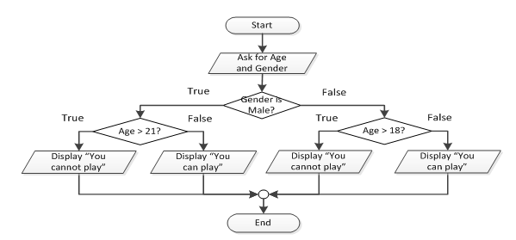
Flow chart Illustration

Slide 7
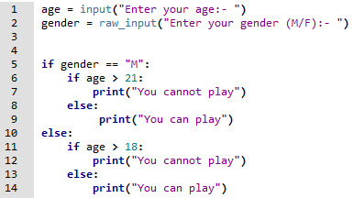
Code according to flow chart

Slide 8
Programming Challenge 10
Write a program to check and display if a person is allowed to participate in a contest based on the person’s gender and age according to the table below:
Gender | Allowed | Not Allowed
Male | 21 years and above | Below 21 years
Female | 18 years and above | Below 18 years

Slide 9
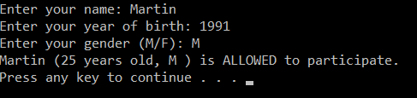
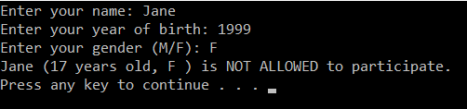
Sample outputs

Slide 10
Programming Challenge 11
Write a program that determines whether a bank customer qualifies for a loan.
To qualify, 2 conditions must be satisfied:
the customer must earn at least $30k p.a.
The customer must be employed at current job for at least 2 years.

Slide 11



Sample outputs

Slide 12
Programming Challenge 12
A department store is running a promotion event for their customers who purchase above $100.
If the customer pays by credit card, they get discount of the total price as follows:
DBS/POSB credit cards – 10% discount
OCBC/OUB credit cards – 15% discount
Write a program that asks the user for the total cost of purchase, whether paying by credit card and bank of credit card if paying by credit card.

Slide 13
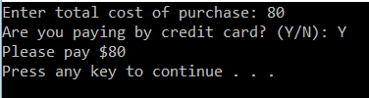
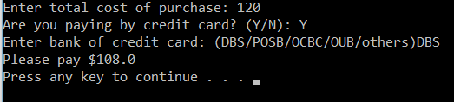
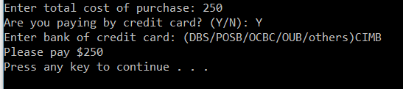
Sample outputs

Slide 14
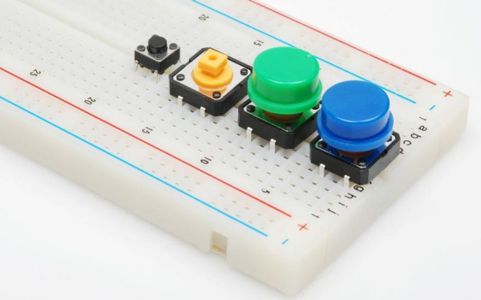
Button
A button is a momentary switch that remains ON when pressed. If it is not pressed, it will be OFF.

Slide 15

Let’s build this circuit
We are going to use the BOARD mode and use the button to ON/OFF the LED.
The LED will remain ON as long as the button is pressed. No programming needed.
Button with green cap
330 $Ω$
3.3 V
physical pin 1
Green LED

Slide 16
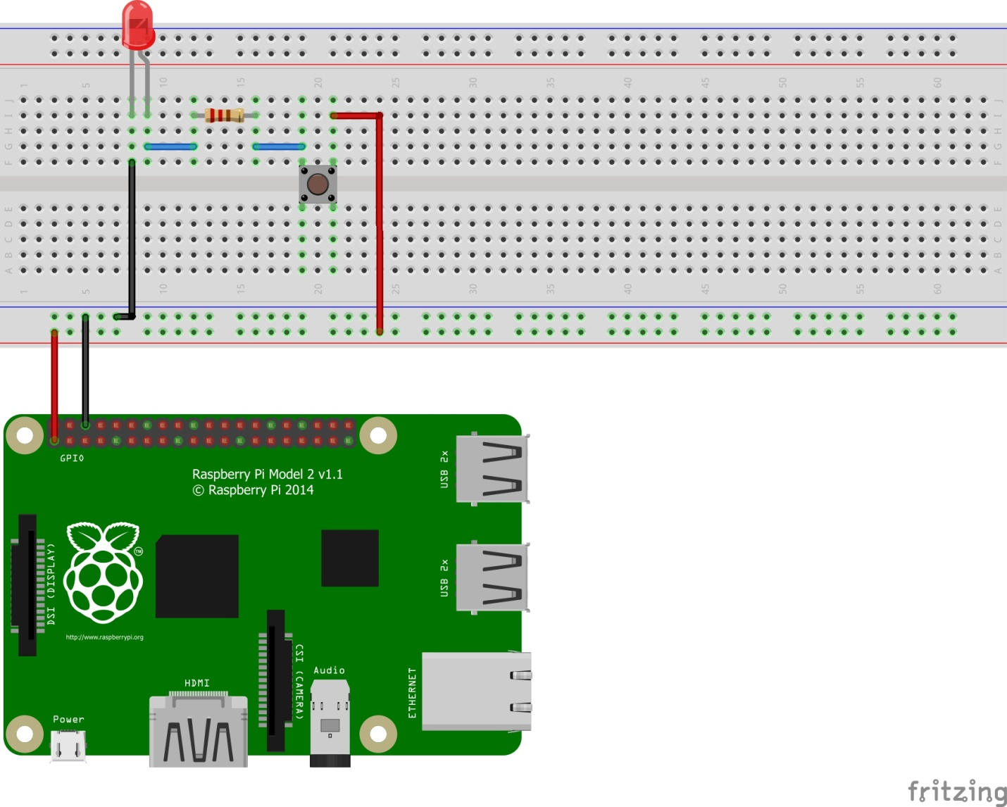
Did your circuit looks like this?
Pin 1 – 3.3V
Pin 6 - GND

Slide 17
Modifying the circuit
Now we are going to change the function of the button.
We are going to program the button such that it will alternate ON/OFF each time it is pressed.

Slide 18
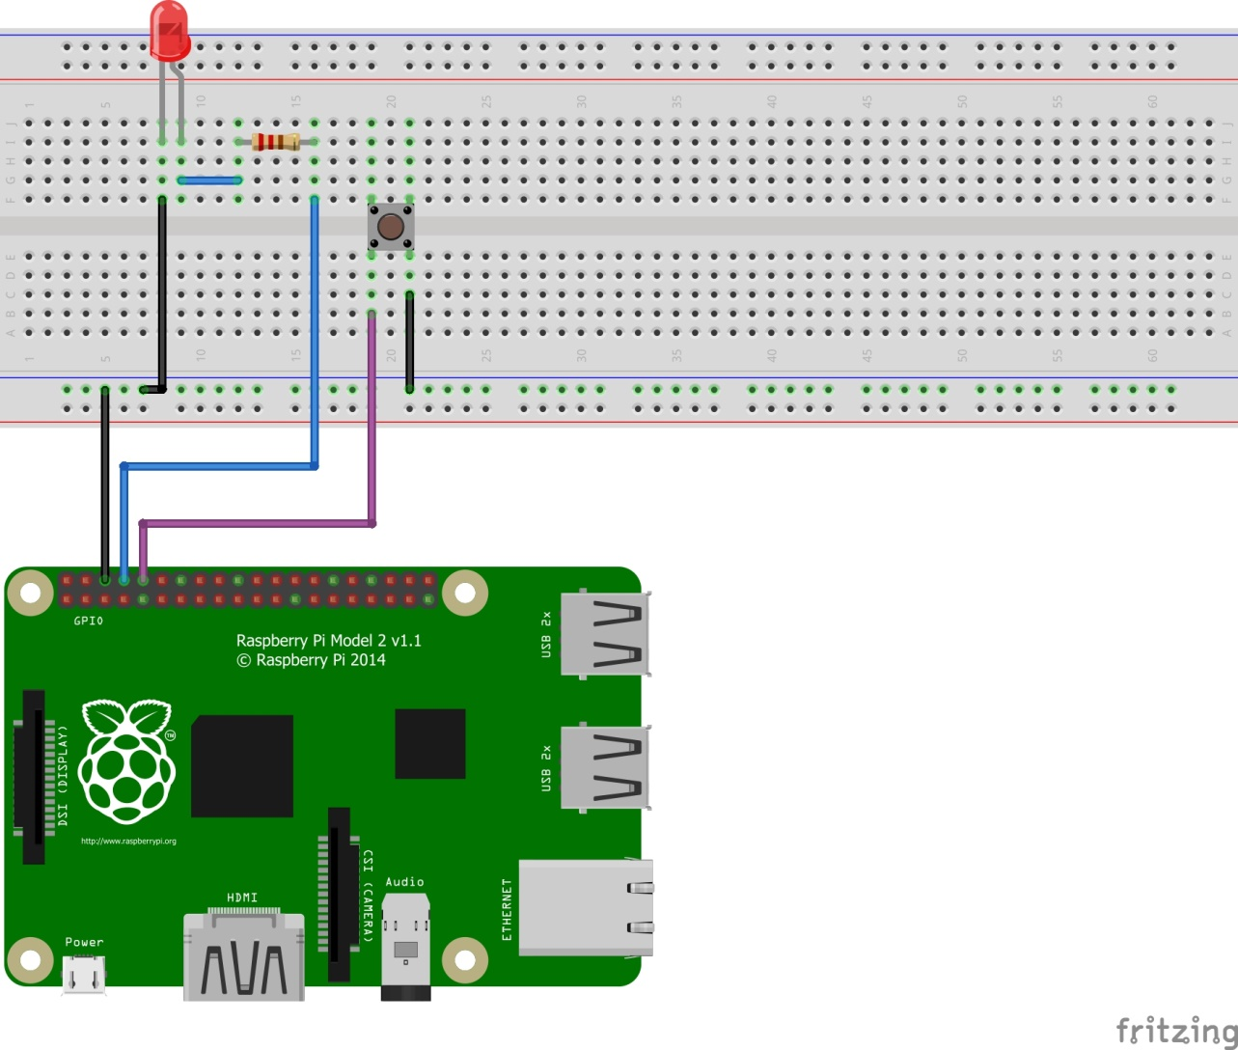
Setup your circuit like this

Slide 19
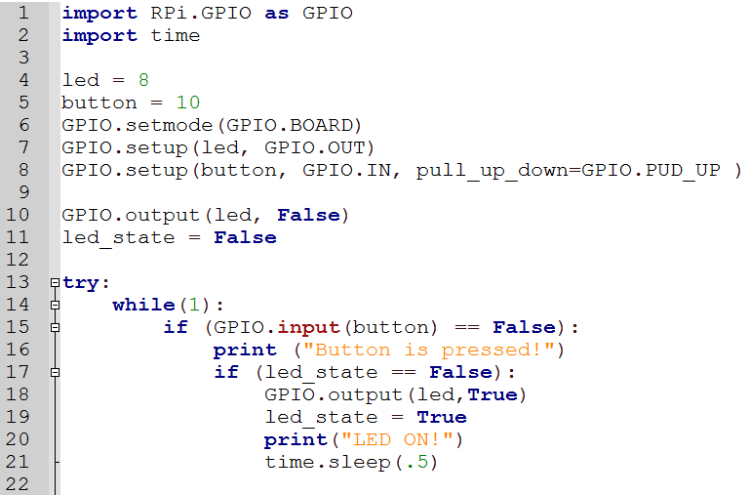
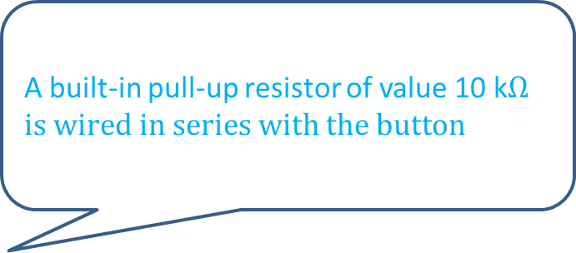
Let’s program it! 1
A built-in pull-up resistor of value 10 k$Ωis wired in series with the button$

Slide 20
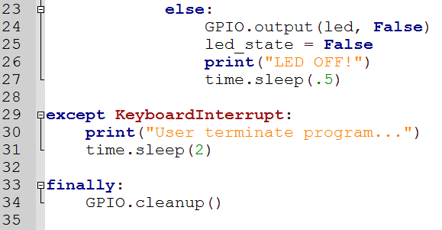
Let’s program it! 2
What do you think is the function of time.sleep() in this program?

Slide 21
RPi Challenge 5
Program the button such that each time it is pressed, the LED will light up for 5 seconds.

Slide 22
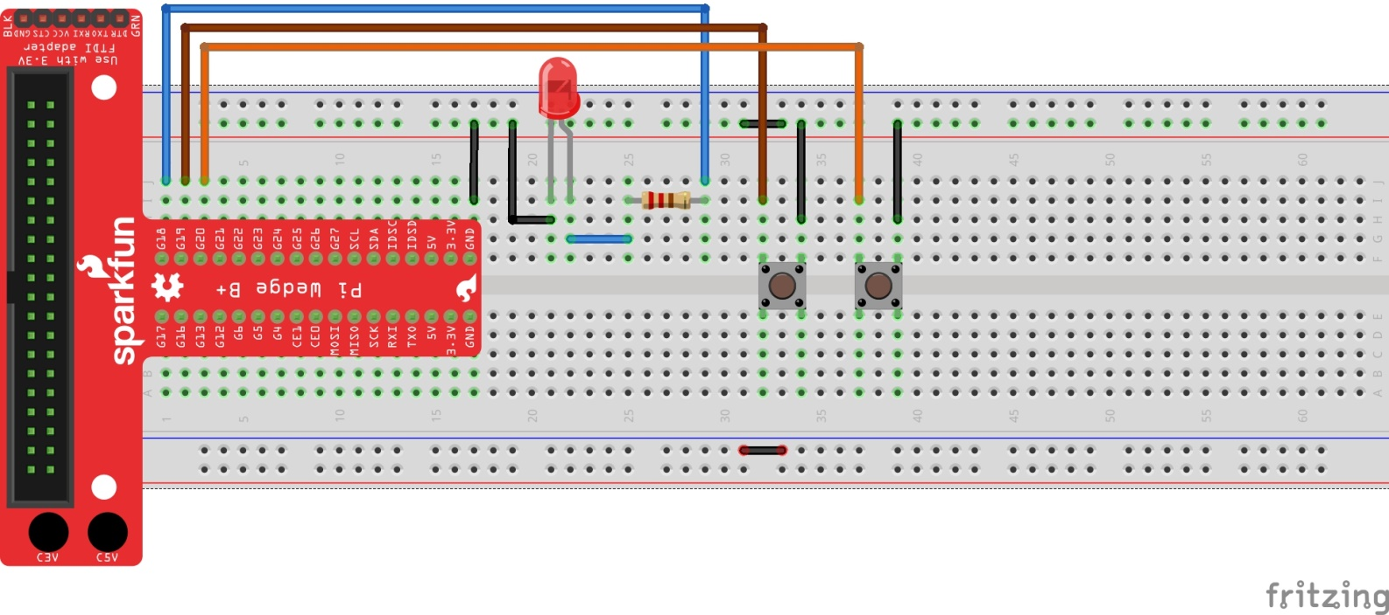
Programming 2 buttons ON/OFF LED
Setup the circuit below

Slide 23
RPi Challenge 6
A) Program such that the left button will ON the LED and the right button will OFF the LED.
B) Program such that the LED will only light up when both buttons are pressed simultaneously.

